Slide 1
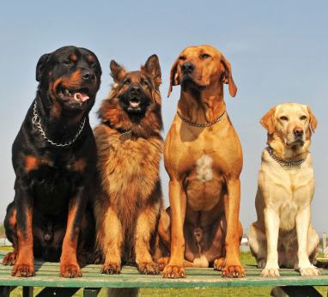
T09 - Hub Dawgs
Sam Bonafe, Cameron Connell, Tri Nguyen, and Evan Williams
“Chess holds its master in its own bonds, shackling the mind and brain so that the inner freedom of the very strongest must suffer.” – Albert Einstein

Slide 2
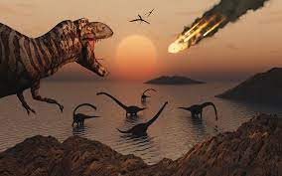
The Game: Extinction Chess
There is no checkmate or check
Instead, a player wins when their opponent does not have at least one piece of every type
All other standard rules apply

Slide 3
Progress:
Finalized functionality in server-class skeletons:
MovePiece can validate all possible moves
Board detects win conditions
Finished Game and Player classes & finalized User class functionality
Requests to server to move piece
Significant improvements in test-coverage
Added test cases for java classes
Added test cases for react classes

Slide 4
Process & Decisions:
Process:
Started the sprint with most of the general functionality implemented in back-end classes
Finalized functionality in edge classes & made adjustments to accommodate special cases
Spent most of the Sprint connecting the front and back ends
Decisions:
Used MongoDB instead of black-bottle
Work on requests and connecting front to back before implementing more specific functionality
Try to use snackbar alerts for notifications/errors

Slide 5
Design Patterns:
If we had the time to implement them, these are some of the patterns that may have been useful:
Factory for the Pieces
Reduce complexity in game-board initialization
Builder for the Board
Board class would not have to initialize itself
Decorator (or something similar) for special moves or pawn promotion
Reduce MovePiece class complexity
There was not much time or need to implement many design patterns but we did use:
Template for the Pieces
Allowed for piece-specific move pattern implementation
High Cohesion
Worsened coupling issues, but classes are well-defined and execute singular, aggregate tasks (making a move)

Slide 6
Ceremonies:
Schedule:
1 Sprint during P3
Things that went well:
Active communication
Teamwork to problem-solve product code and environment issues
Work was thoroughly reviewed
Things that we need to improve:
Similar things from previous sprints (distributing work, less wait-time on PRs)
GitHub etiquette and writing clean code
One thing we would change for the future:
Clearly defining expectations from team-members

Slide 7
Project Demonstration:

